Slide 1
ROCK PAPER SCISSORS GAME
NAME: Shaik. Mubeen Ahmed PLATFORM: Dev C++ TOPIC: GAME DEVELOPMENT PROJECT

Slide 2
INTRODUCTION
The Rock-Paper-Scissors game is a popular hand game recreated in C++ to demonstrate interactive console-based programming. This project allows the user to input choices in various formats (R/P/S or full words), while the computer randomly selects its own. Using functions, string handling, and decision logic, the program determines the winner and provides a replay option. It showcases how basic programming concepts like conditionals, loops, user input, and random number generation can be used to develop fun and engaging applications.

Slide 3
OBJECTIVES OF THE PROJECT
To understand the logic behind turn-based games
To learn about rand() function and user input
To develop simple decision-making programs
To strengthen coding, debugging, and logical thinking

Slide 4
WHAT IS ROCK PAPER SCISSORS GAME?
A game where each player simultaneously forms one of three shapes:
Rock crushes Scissors
Paper covers Rock
Scissors cuts Paper The outcome is either Win, Lose, or Draw based on these rules.

Slide 5
GAME COMPONENTS
Choices: Rock (1), Paper (2), Scissors (3)
User vs Computer
Randomized computer choice
Score Tracking (optional feature)
Loop for replaying

Slide 6
LOGIC AND FLOW OF THE GAME
Display menu (Rock/Paper/Scissors)
Take user input
Generate computer choice using rand()
Compare both inputs
Display result
Option to play again

Slide 7
TOOLS USED
Dev C++: IDE for compiling and running C++ programs
Standard C++ Libraries:
iostream for input/output
cstdlib and ctime for random generation
Basic Algorithms & Logic

Slide 8
KEY LEARNINGS
Writing interactive console applications
Using switch-case and if-else structures effectively
Handling random number generation in C++
Enhancing logical and algorithmic thinking
User-friendly programming practices

Slide 9
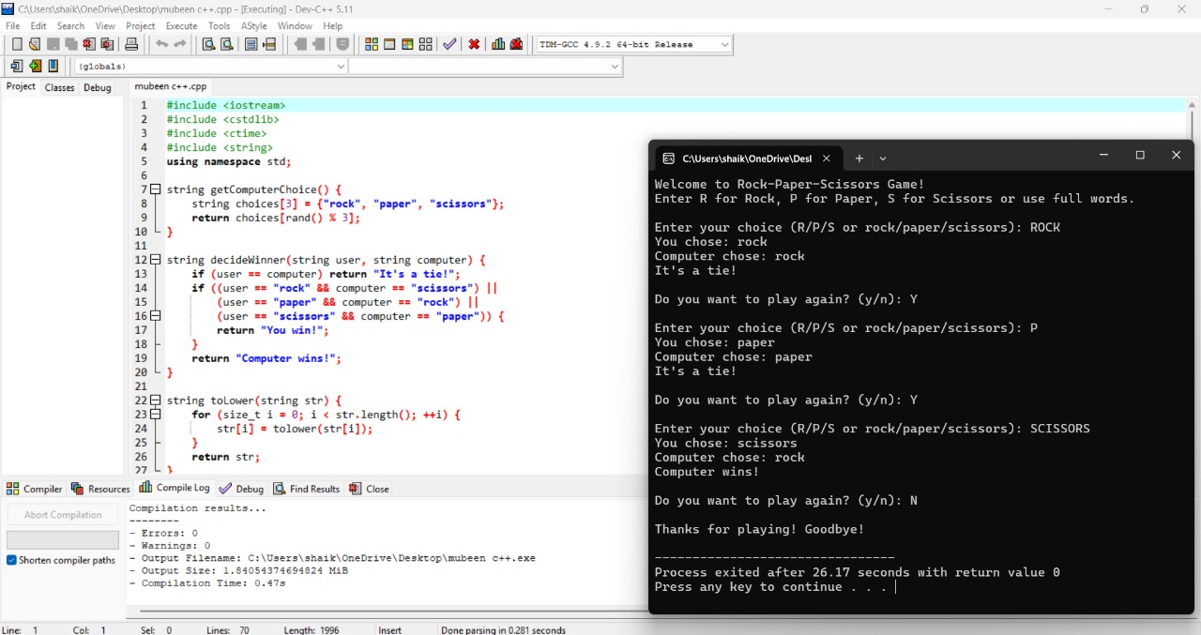
SCREENSHOT

Slide 10
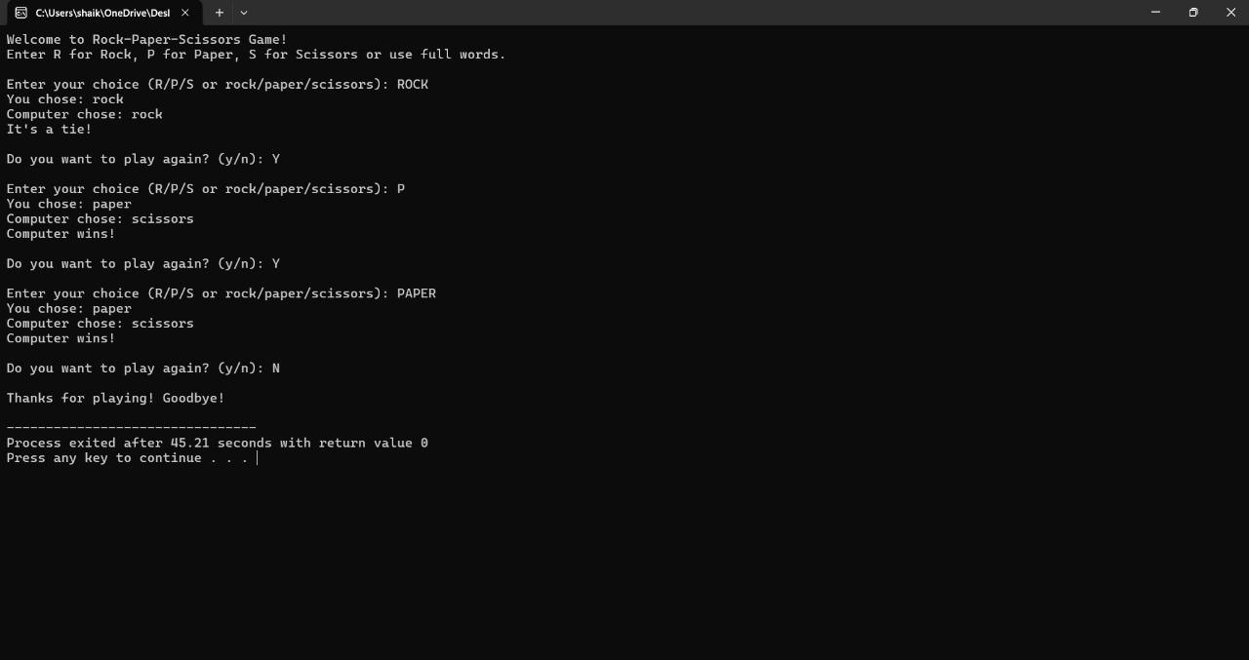

Slide 11
CONCLUSION
This project improved my understanding of game logic, user input handling, and randomization in C++. It was a fun and educational experience that enhanced my C++ coding skills and creativity in game design.

Slide 12


